Slide 1

Ranjith Kankanala
Ken Yeh
Theresa Keh

Slide 2

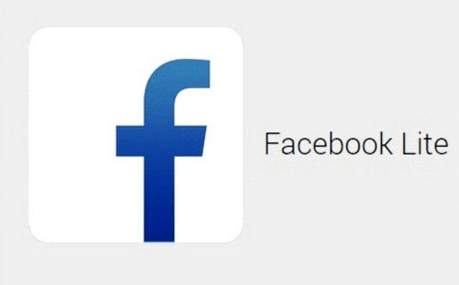

Motivation
Profitability is dictated by number of downloads
What drives app downloads?
Projecting the number of downloads can help us raise advertisement revenue for free apps
Are customers more attracted to leaner more compact apps? Should companies invest in “lite” version of Apps
versus
Notes:
Companies nowadays are making smaller / more compressed sized apps
are we delegating our resources the most efficient way to make profit?
Ex. Facebook lite → FB is developing 2 apps, is this a good business model??
Our Dataset → Kaggle

Slide 3
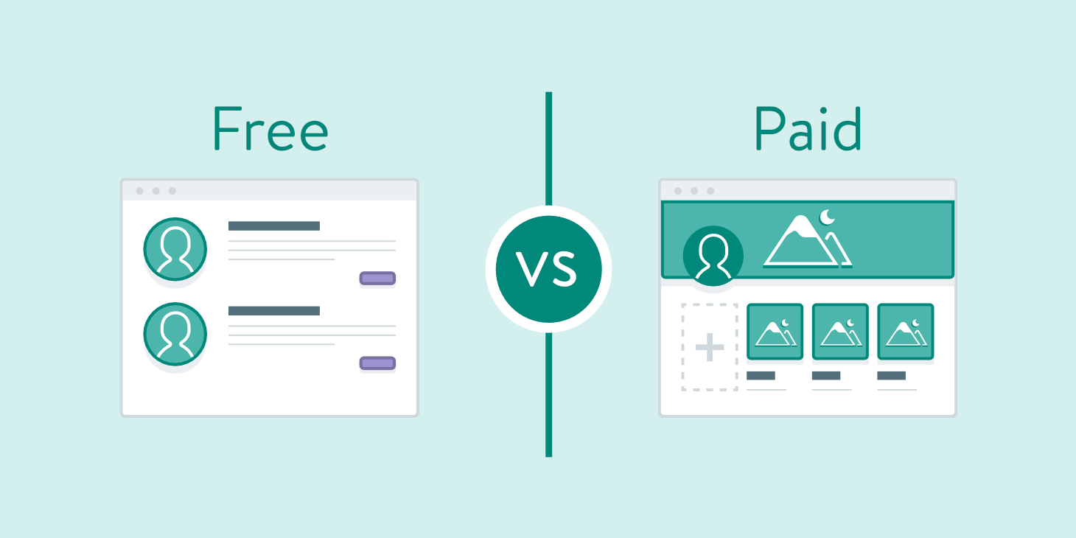

Free/Paid Apps; Size of apps
We believe the type of App (Free/ paid) is a significant factor:
Free apps
Paid apps
Apps that displays size info
Size
Notes:
Separate between free vs paid
Some free apps have microtransactions that require payment so this dataset does not account for that something something more comprehensive dataset
We think these are significant factors that should be separate in different data frames

Slide 4
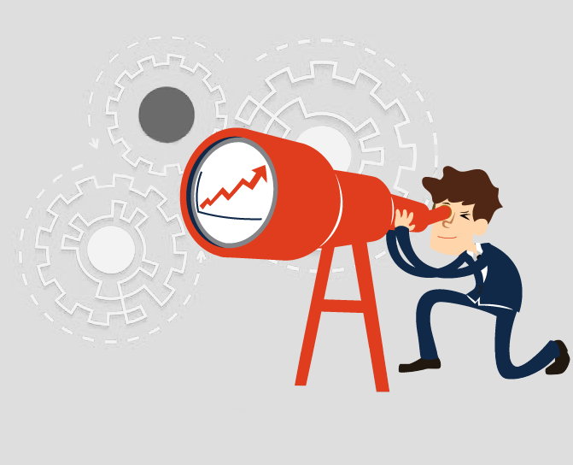
Assumptions
Free apps are actually free
Size of the apps are fixed, no additional files post installation
Notes:
Initial app vs additional download

Slide 5
Variables in Our Original Dataset
App Name: Character String
Rating: Numeric, 0 to 5 stars
Reviews: Numeric
Size: Numeric in mB/kB
Installs: Categorical Data
Type: Free/paid
Price: in US Dollars
Content Rating: Categorical Data
Genre: Character String
Last Updated: in Month, Date, Year
Current Version
Android Version

Slide 6
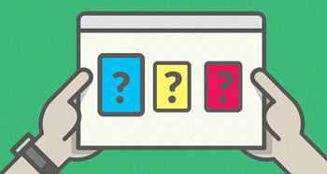
Our Feature transformations
Popular (Dependent variable derived from number of installs)
Category Main ( Factor Lump the top 8 Categories and lump everything else in Other)
Genre_Main (assigning a primary Genre
Bytes ( Transformed kb and mb into bytes)
Poor Data Scraping lead to a lot NaN for Ratings. Converted all NaN to 0’s
Notes:
Category main take top 19 categories and put all in an other
Take first genre, categorize that and see which genre is weighed the heaviest.
Bytes → we converted everything to uniform measurement
KEN
Review, cleanup After we cleanup data then we can do tests
Some genres there are multiple we are just taking the first one the most dominant genre

Slide 7
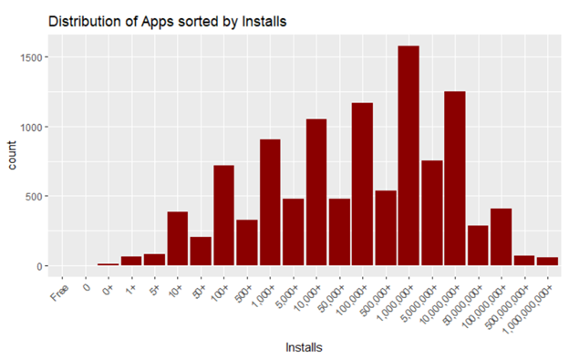
Installs Distribution
Installs is one of our dependent variables.
We deemed 1 million download count as “popular”
Notes:
Distribution of Apps sorted by Installs
Our dependent variable: installs
We selected a 1 million download count. That is what we deemed as popular. This is the distribution of our dataset.
Like Ranjith said earlier, one of our motivations for this project was to try and understand if the size of an app has an effect on popularity of an app.
Companies nowadays are making smaller / more compressed sized apps

Slide 8
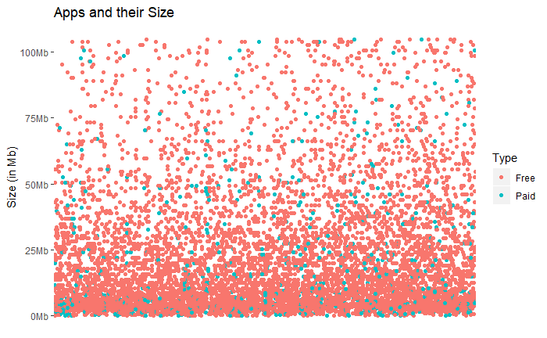
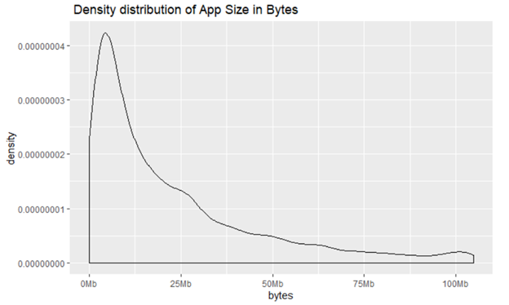
Jitter Graph: Apps and their Size
Most of application in this store are free (~93.1%)
Most apps are under 25 MB
Notes:
Jitter Graph: Apps and their Size
Most of applications in this store are free (They account for ~93.1% in this dataset)
Most apps are also concentrated in smaller sizes
We found that most top rated apps are optimally sized between ~2MB to ~40MB, neither too light nor too heavy.
Most bulky apps (which we consider > 50 MB) belong to the Game and Family category. Will talk about this more when we compare apps by genre category.
Again, we are under the assumption that free is free, and this dataset doesn’t take into account free apps that may have microtransaction/payments within them.

Slide 9
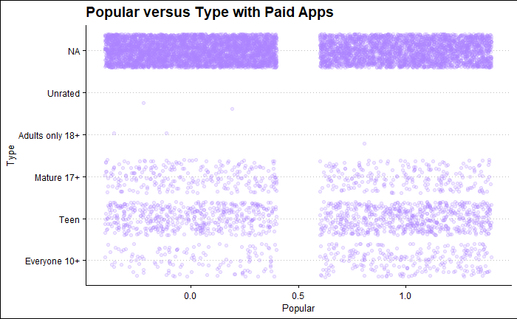
Jitter Graph Content Rating Distribution
Ignoring the N/A, it seems that most apps are geared towards teens and older.
There are a lot of apps in the N/A category so maybe content rating might not the ratings too much.
Notes:
Jitter Graph Content Rating Distribution
Ignoring the N/A, it seems that most apps are geared towards teens and older.
There are a lot of apps in the N/A category so maybe content rating might not the ratings too much
Though from our findings it seems like Mature applications ,look like they get lower rating than other.

Slide 10
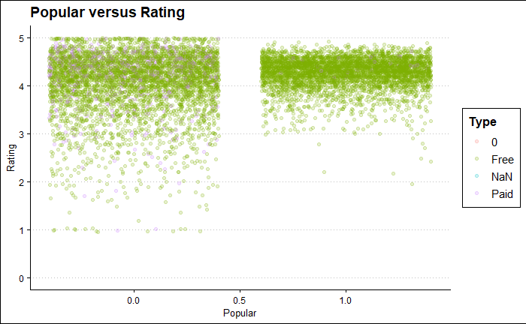
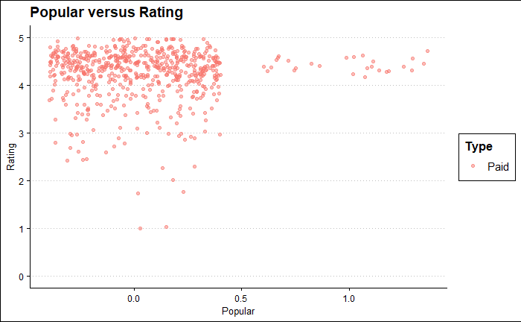
Popular vs. Rating
Paid Apps tend to be not popular
Popular apps have a higher rating
For both free and paid apps, most are highly around 4-5
Notes:
Popular vs. Rating This graphs show popular vs rating
On the Left: shows both free and paid but really can only see FREE because so many free apps in this dataset
On the Right: same thing but we isolate Paid Apps. Paid apps tend to not be as popular.
Paid Apps tend to be not popular
For both free and paid, most apps are highly rated around 4 - 5
This makes me question if there is a bias or some type of incentive on certain apps for users to post reviews
Such as in a game, getting a free item or coins in exchange for a review.
We also found that popular apps have a higher rating
In another graph where we were observing Installs vs # of Reviews, we found:
People are less likely to install if they see few to no reviews
Makes sense, because as a consumer an app having no reviews doesn’t necessarily dissuade me from downloading app but it doesn’t make me jump out to go and download it either.
When I see an app with tons of review, even if it it may not seem like I need the app or that the app is for me, I am likely to download it out of hype and curiosity.

Slide 11
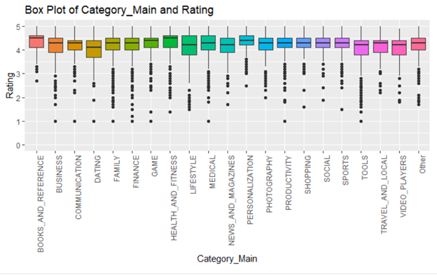
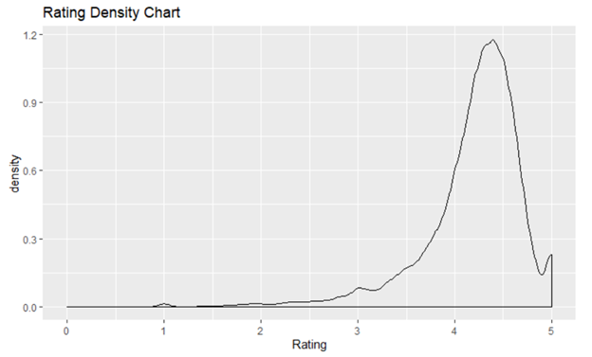
Ratings Distribution and Category_Main and Ratings relationship
Dating Apps have the lowest rating on average
Average rating of apps
Average app rating = 4.17
Notes:
Ratings Distributions and Box Plot of Category_Main and Rating this breaks down the ratings, this time by genre
Again this tells us that most apps ranked at 4-5 regardless of category ranked highly.
The Box plot: Do any apps in certain categories perform really good or really bad?
It seems like Dating Apps have the lowest rating on average
Average rating of apps
Average app rating = 4.17

Slide 12
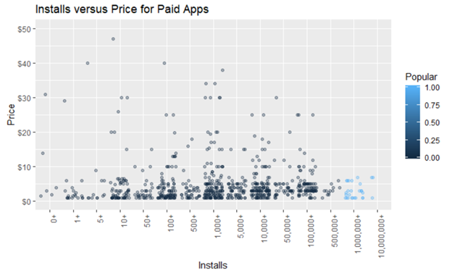
Installs versus Price for Paid Apps
There were a lot of junk apps priced above $250, categorized under family and lifestyle variations of apps called "I am rich"
Outliers so we decided t o cut the y lim to $50
Most popular paid apps installed cost from $0-$10
Most expensive apps were Medical
Notes:
Installs vs. Price for Paid Apps
There were a lot of junk apps priced above $250, categorized under family, lifestyle, and finance genre category variations of apps called "I am rich"
Because of these outliers @ ridiculous prices, we decided to cut the y lim to $50
Most popular paid apps installed cost from $0-$10
I Am Rich: a simple piece of software that “displayed a glowing red gem and an icon that, when pressed, displayed the following mantra in large text:”
I am rich I deserve it I am good, healthy & successful

Slide 13
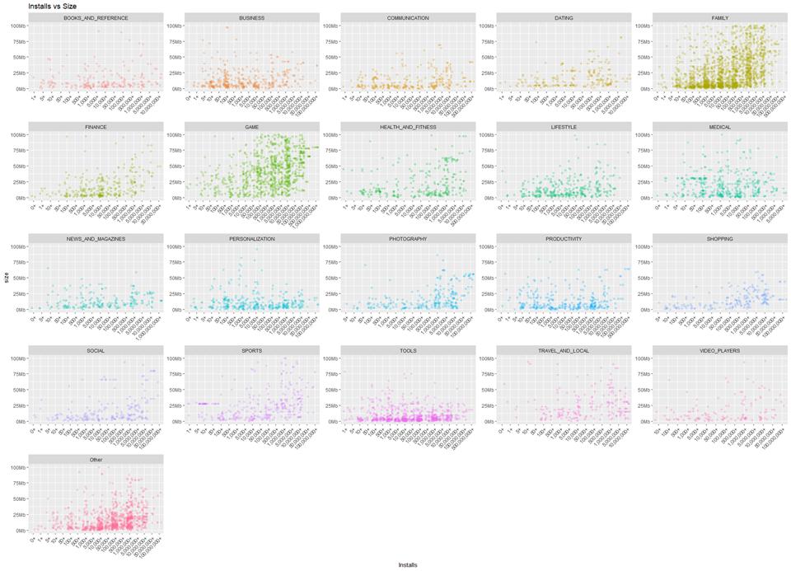
Install versus Size
Family and Game apps have the highest market prevalence.
Shopping, Tools, and New and Magazines genres tend to be smallest in size of apps
Most top rated apps are optimally sized between ~2MB to ~40MB - neither too light nor too heavy.
Notes:
Install vs size by genre
Here we used facet_wrap which is great because it enables us to create small multiple charts easily and effectively. This provides a clearer picture.
One of things we were questioning was does size impact the app rating or number of installs?
We found that:
Game and Family Category Apps seem to have higher downloads and size. Both genres also seem to have a number of apps that are quite large in size as well.
Shopping, Tools, and New and Magazines genres tend to be smallest in size of apps
Most top rated apps are optimally sized between ~2MB to ~40MB - neither too light nor too heavy.

Slide 14
Can more be interpreted from this?
Most Apps are under 25 MB
Notes:
Density distribution of App Size in Bytes
Most apps are small in size
Can more be interpreted from this?
Distribution, bus motivation do smaller apps garner more .

Slide 15
Ratings Distribution
Most apps are in the 4 to 5 Stars ratings range
Notes:
Rating Density Chart Most apps rated 4 or 5
Delete?? Honestly it says the same shit as the previous slide for Popular vs Rating.

Slide 16
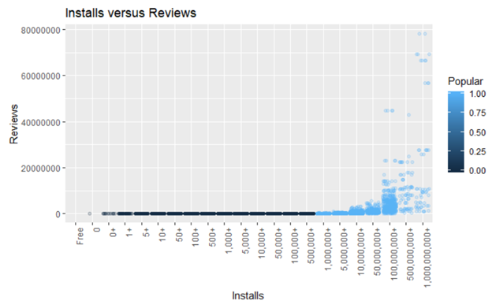
Installs vs Reviews
Notes:
Installs vs Reviews
People are less likely to install if they see few to no reviews
Makes sense, because an app having no reviews doesn’t necessarily dissuade me from downloading app but it doesn’t make me jump out to go and download it either.
When I see an app with tons of review, even if it it may not seem like I need the app or that the app is for me, I am likely to download it out of hype and curiosity.

Slide 17
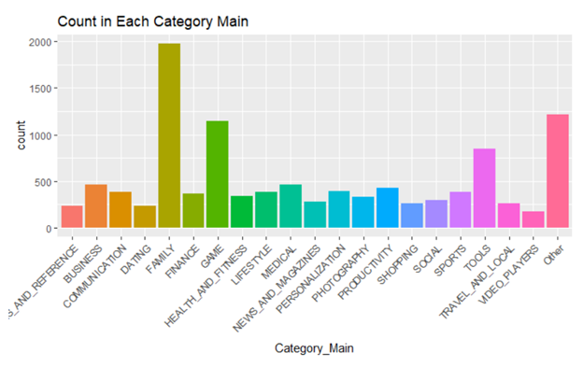
Count in Each Category Main
Notes:
Most apps are in the family genre, followed by game genre apps.
Dating, book and reference, and video players genres have the least amount of apps
Is there more to be said about this? I just like that it is colorful and pretty

Slide 18
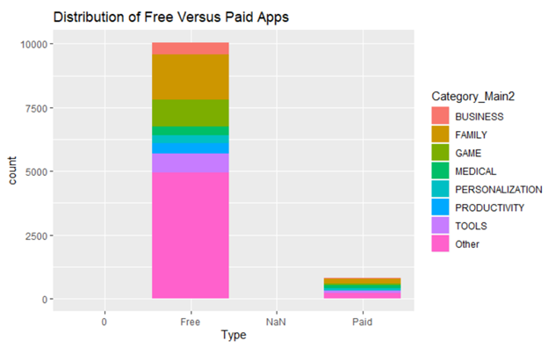
Delete??
Notes:
Distribution of Free Versus Paid Apps
Most are free and can see breakdown by genre by color
Is this really telling us much more than the previous slide?
MAY DELETE

Slide 19
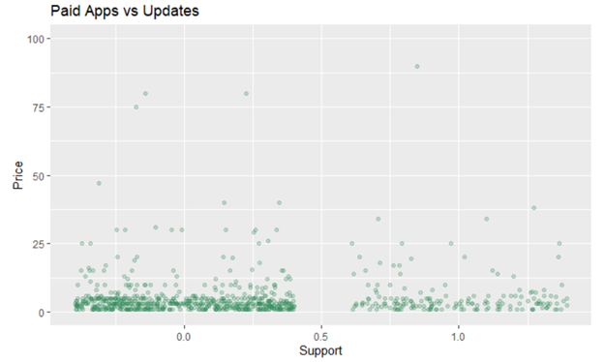
→ ask ken for clarity
Notes:
'Paid Apps vs Updates'
A lot of apps are not supported anymore → ask ken for clarity

Slide 20
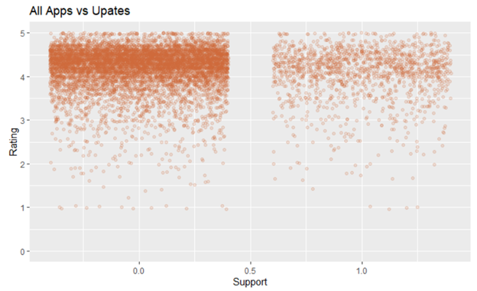
→ ask ken for clarity
Notes:
'All Apps vs Upates'
Ask for clarity ken

Slide 21
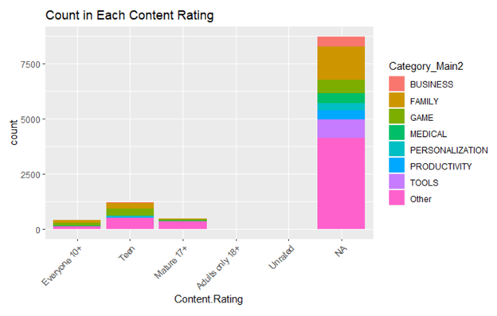
Delete??
Notes:
Count in Each Content Rating Too similar to previous graph may delete.

Slide 22
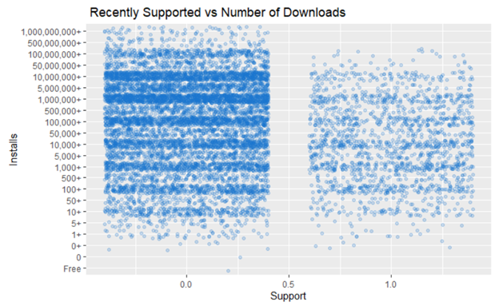
→ ask ken for clarity
Notes:
Recently Supported vs Number of Downloads
Might not matter if updated frequently?? Ask ken

Slide 23
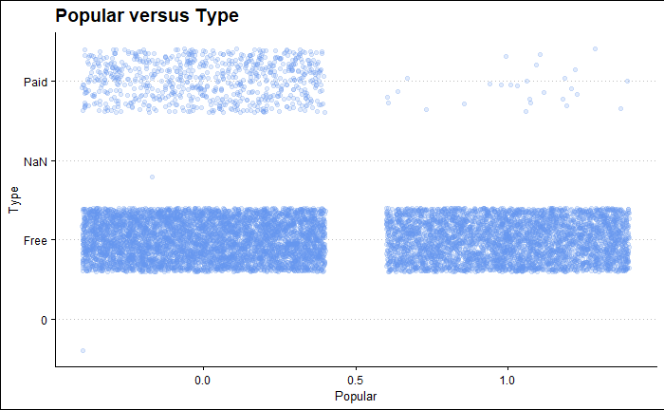
Delete??
Notes:
Popular versus Type
Cross tabulation of 2 categorical data, you can see that Paid Apps tend to not be "popular"
Free apps seem to be evenly distributed between "popular" and not
May take out

Slide 24
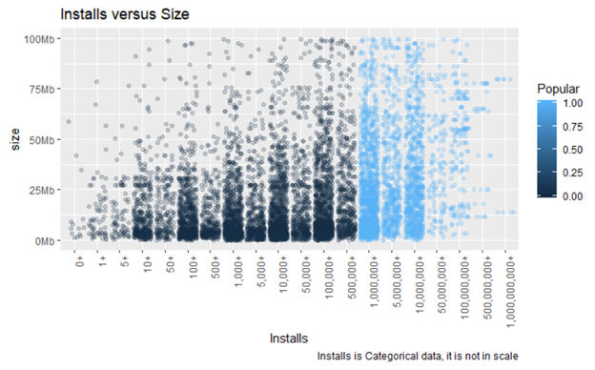
→ ask ken for clarity
Notes:
Installs versus Size
Installs is Categorical data, it is not in scale
How to interpret?

Slide 25
Interesting plots and findings after transformation
Notes:
After transforming the datas these are the graphs we made
Dating apps had the lowest… Whatever we found interesting

Slide 26
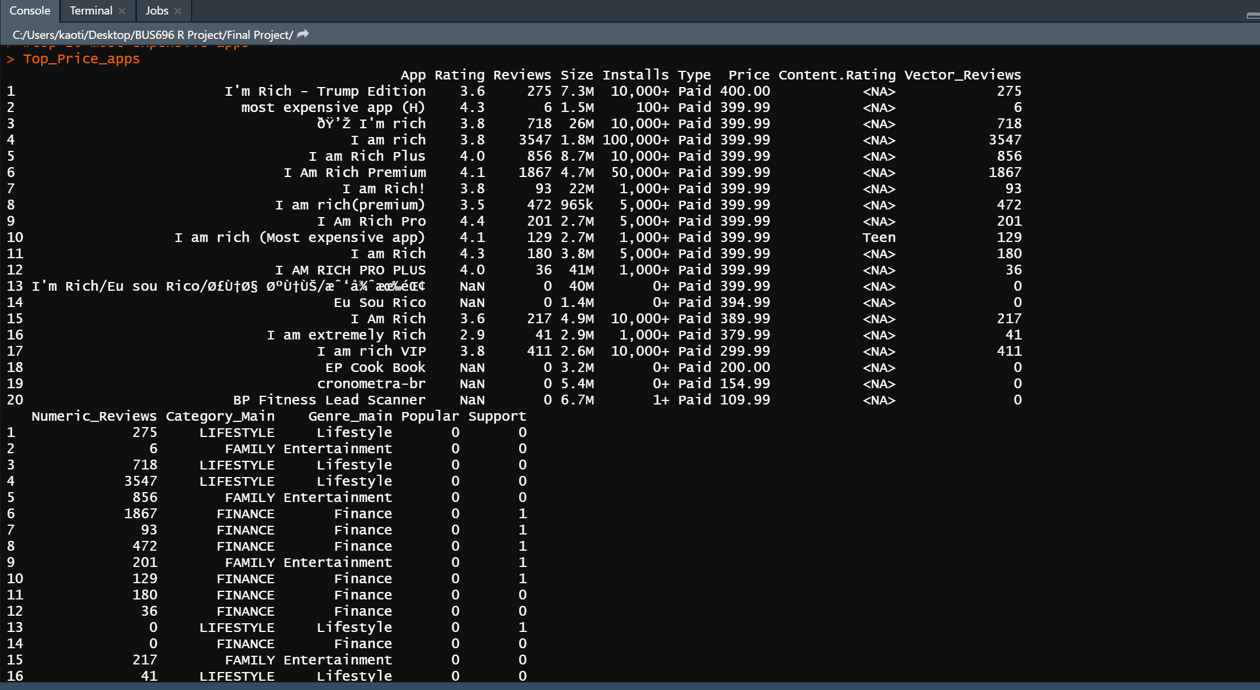
The Most Expensive Apps in our Dataset

Slide 27
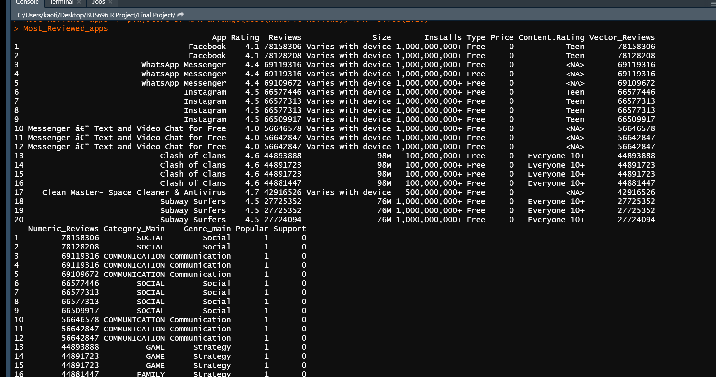
Most Reviewed Apps in our Dataset

Slide 28
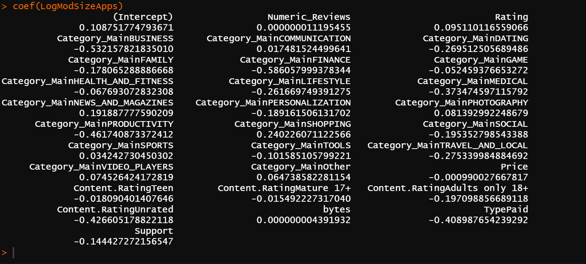
Logistic Regression Model (has bytes)
Book and Reference is the reference group for Category_main
Everyone 10+ is the reference group for content rating
Notes:
Logistics model
Output is popular
Missing: RMSE Check with test data, overfitting?? test/train We have low low low coefficient because the numbers we are dealing with are really big
Our output are also at the extremes of 0 and 1
We can’t use linear models we want logistic model, classification type of regresions, random forest

Slide 29
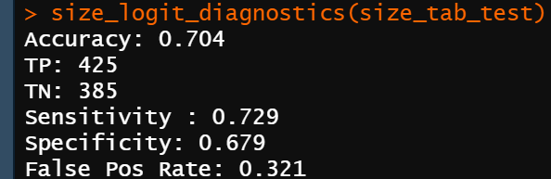
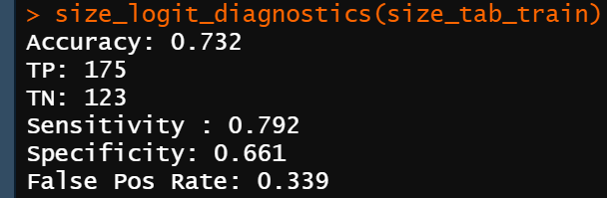

Slide 30
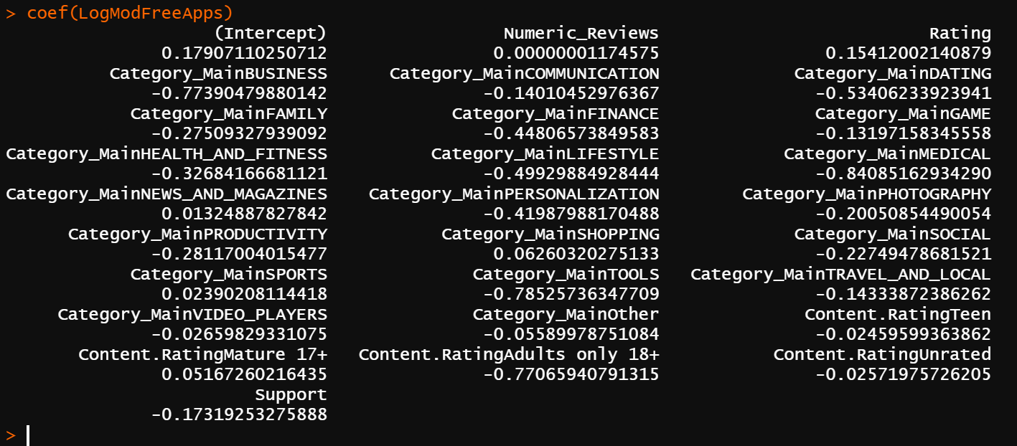
Logistic Regression Model (free apps)
Book and Reference is the reference group for Category_main
Everyone 10+ is the reference group for content rating

Slide 31
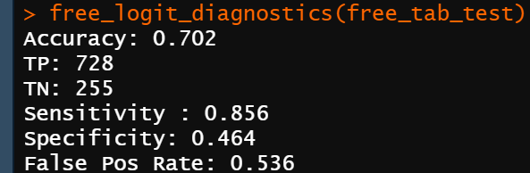
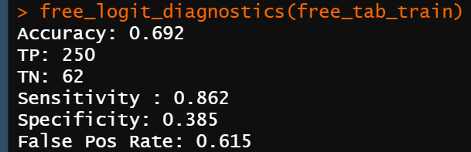

Slide 32
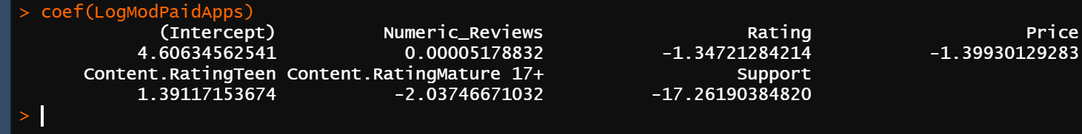
Logistic Regression Model (paid apps)
Everyone 10+ is the reference group for content rating

Slide 33
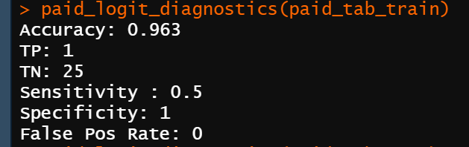
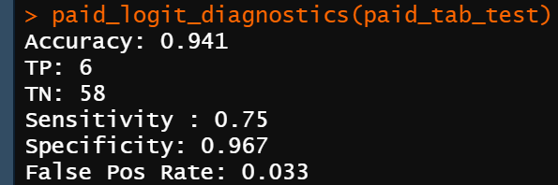

Slide 34
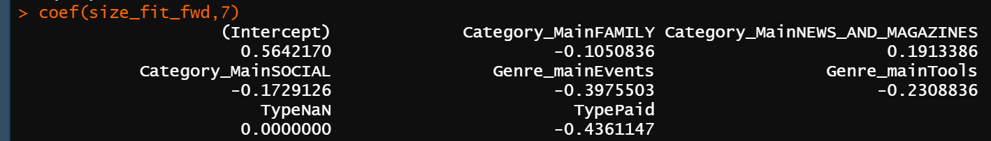
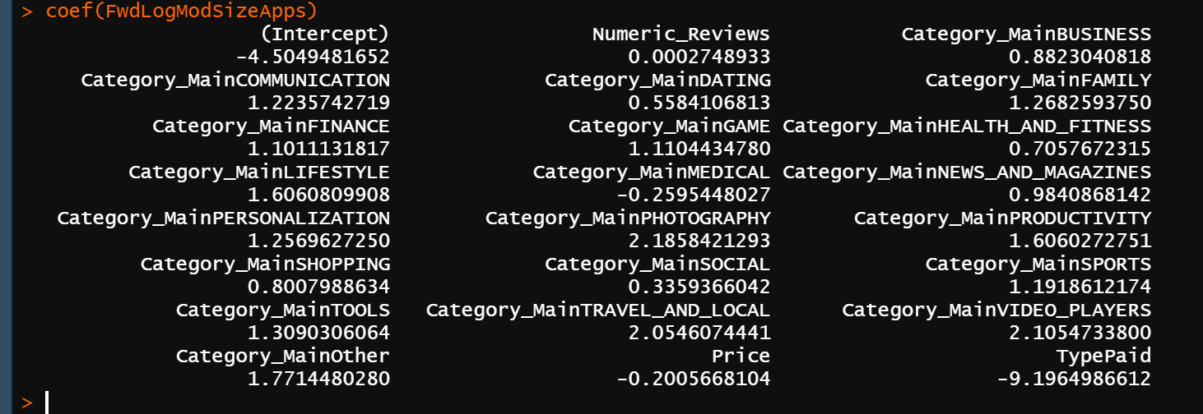
Forward Step Method Selection (has bytes)
Notes:
Forward model Might not work due to being only for linear model

Slide 35
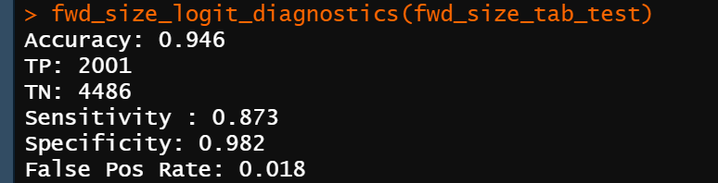
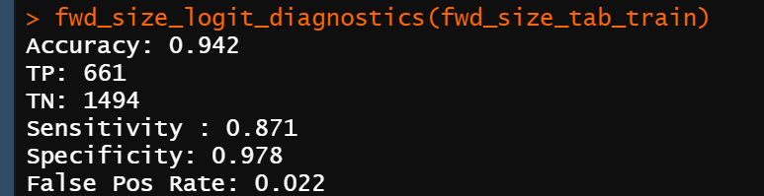
With Forward Step
Without Step forward selection:
Accuracy 70%, False Positive rate 32%
Without Step forward selection:
Accuracy 73.2%, False Positive rate 34%

Slide 36
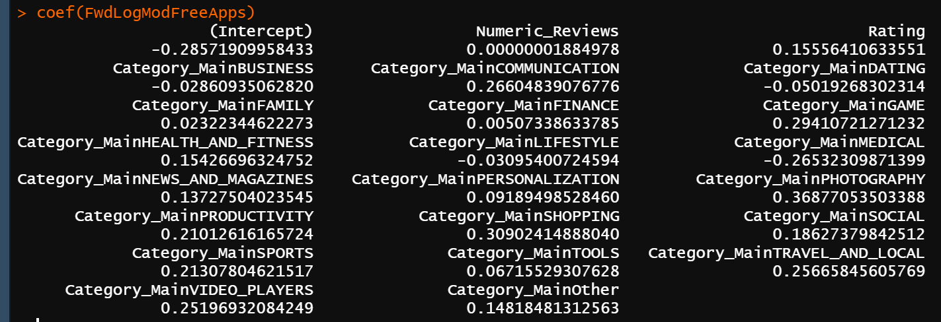
Forward Step Method Selection (free apps)

Slide 37
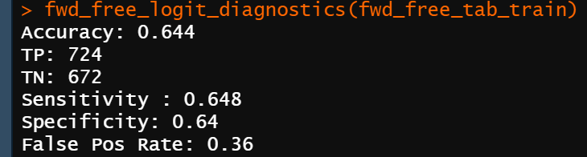
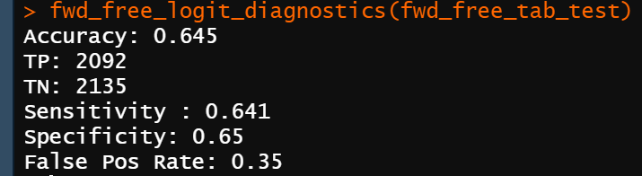
With Forward Step
Without Step forward selection:
Accuracy 69%, False Positive rate 62%
Without Step forward selection:
Accuracy 60%, False Positive rate 53%

Slide 38
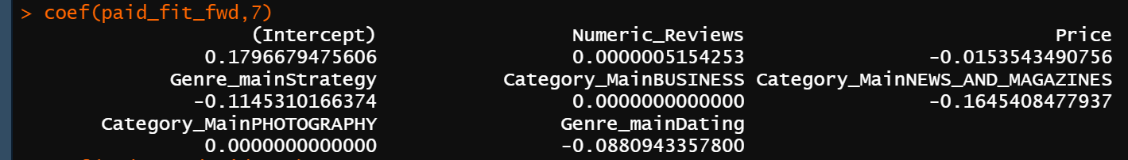
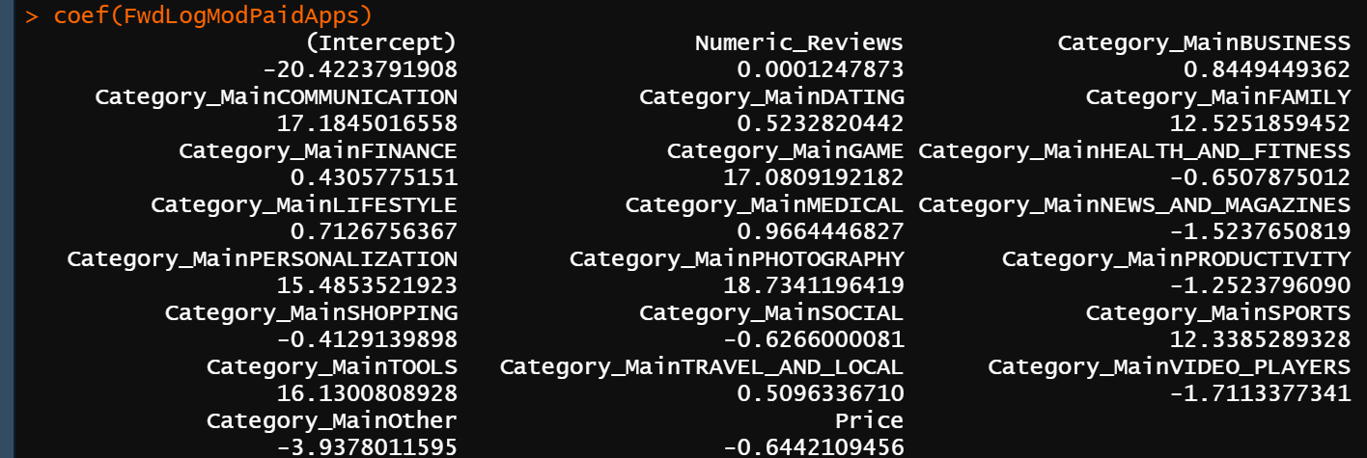
Forward Step Method Selection (paid apps)

Slide 39
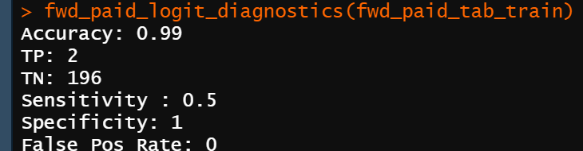
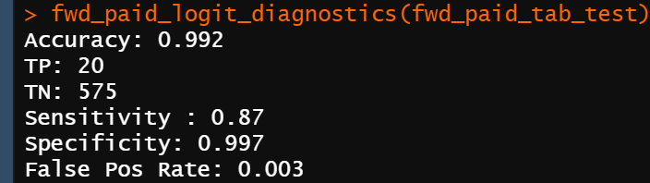
Without Step forward selection:
Accuracy 96%, False Positive rate 0%
Without Step forward selection:
Accuracy 94%, False Positive rate .3%

Slide 40
Model 3 - Predicting the app rating using category, reviews and type

Slide 41
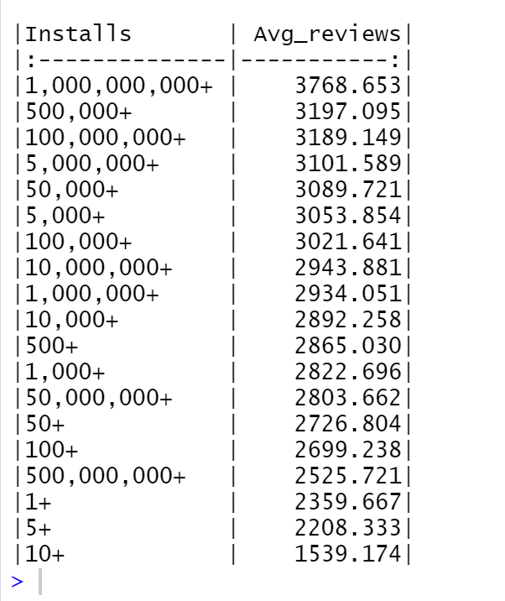
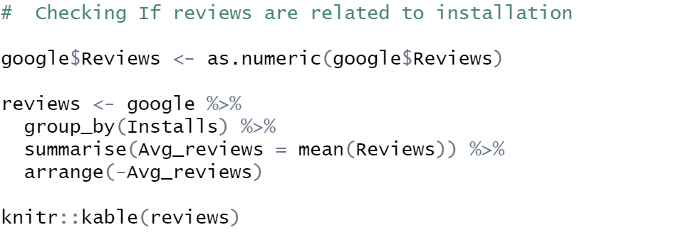
Checking if Reviews are related to downloads?
Notes:
ELASTINET Between ridge and lasso

Slide 42
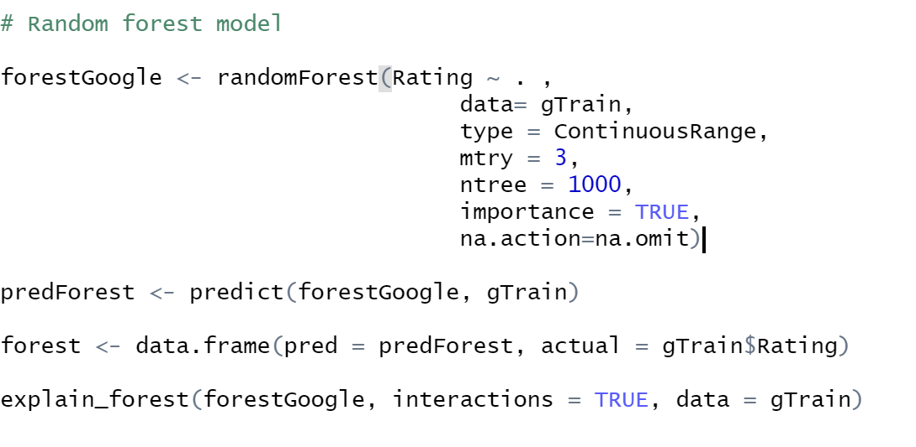
Making dummy data and removing predictors with zero variance.
Checking for variables with zero variance.
Splitting into train and test data.
Randomforest
Notes:
Inconclusive!!!
The bigger the app the more popular it is More functions
Would people

Slide 43
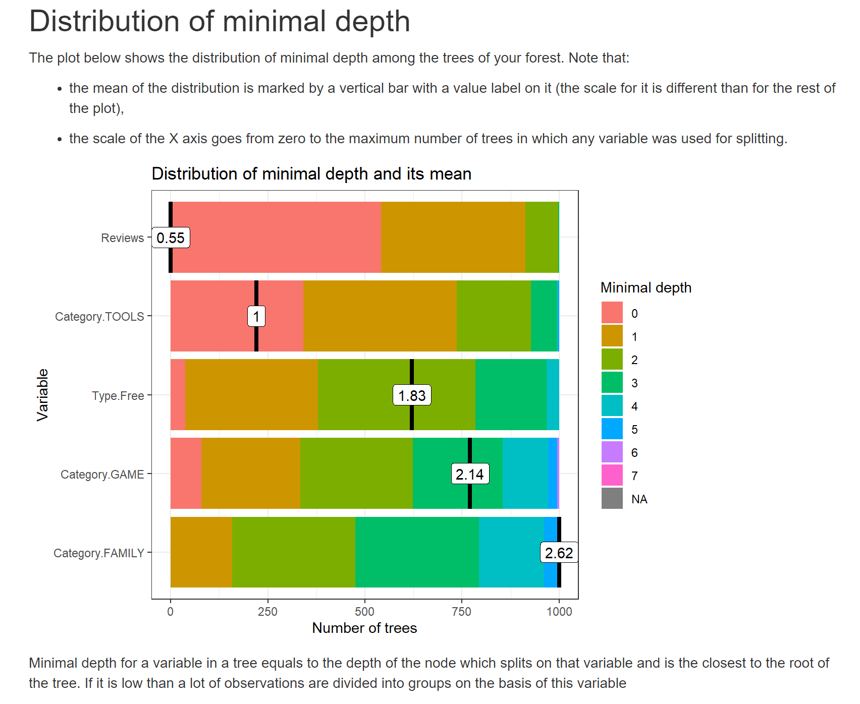

Slide 44
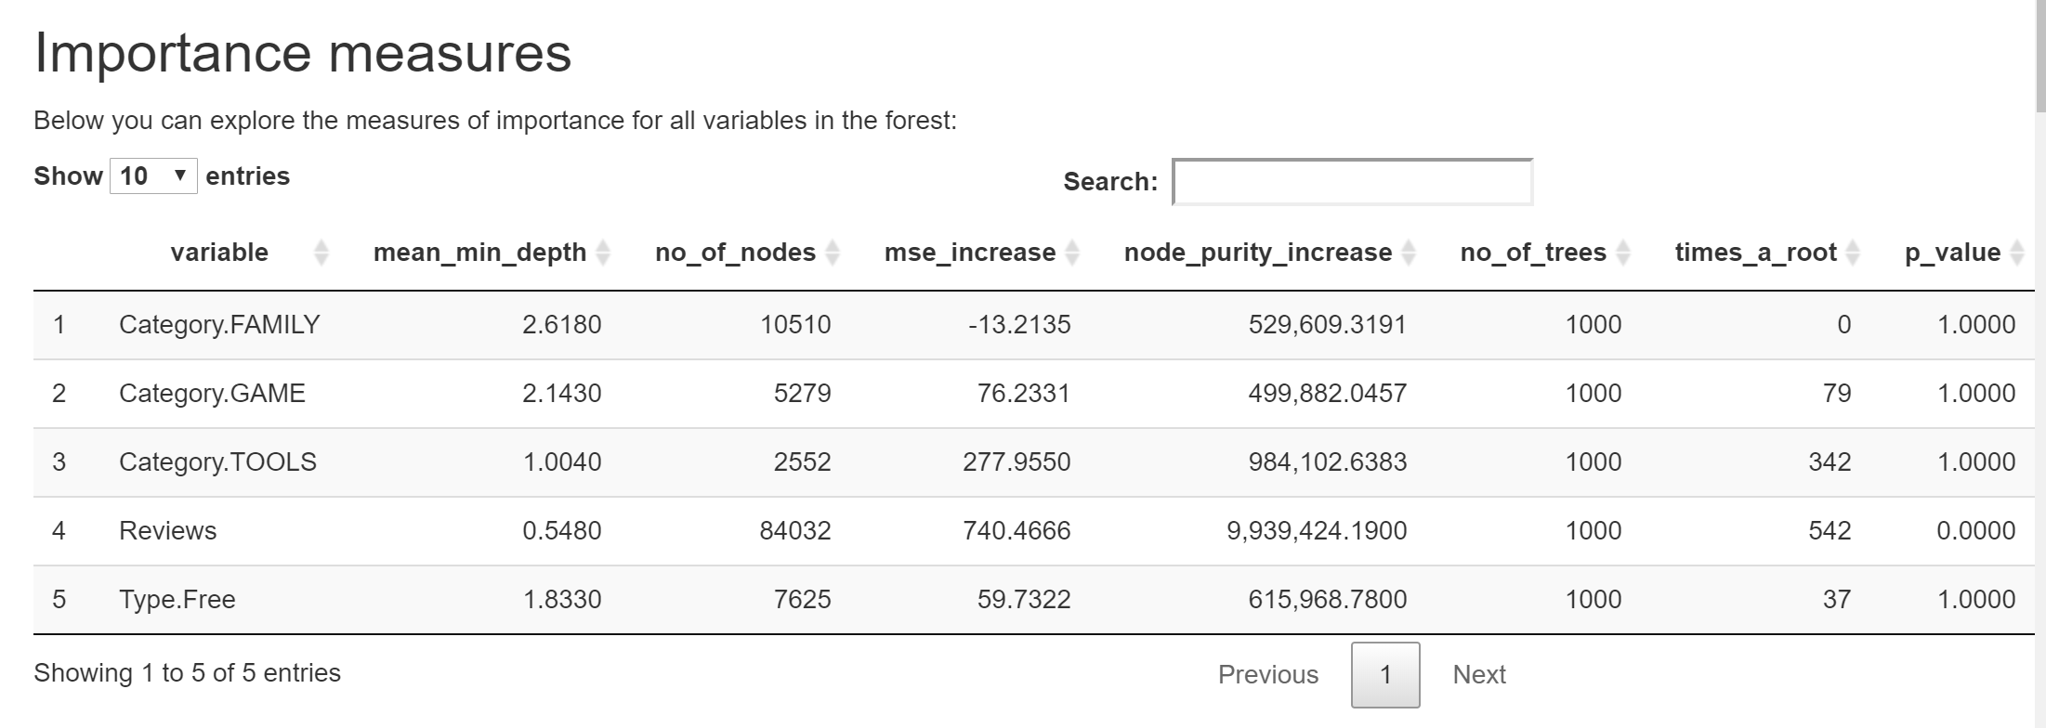

Slide 45


Slide 46


Slide 47
Our Findings
From our logistic regressions, bytes have a positive correlation with positive correlation
Memory storage is only getting cheaper as time goes on.
Instead of developing more compacted apps, companies should just focus on adding more features and services
For Apps with bytes info, we’ve concluded rating and shopping apps are big driver of download. Paid and Medical apps are deterrents of download.
For Paid Apps, Gaming and Photography are big drivers of download. Video players and News and Magazines are deterrents of download.
For Free apps, Shopping and Photography are big drivers of download. Medical and Business are deterrents of download.

